Slide 1
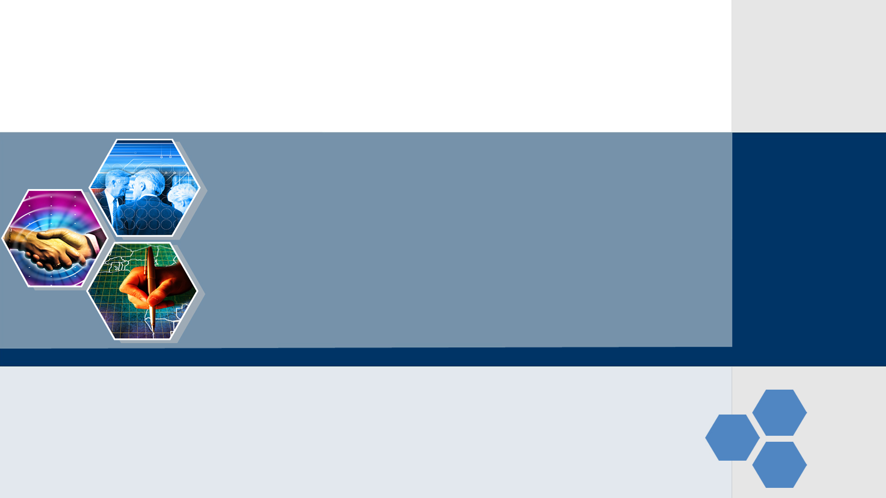
Internet基本概念

Slide 2
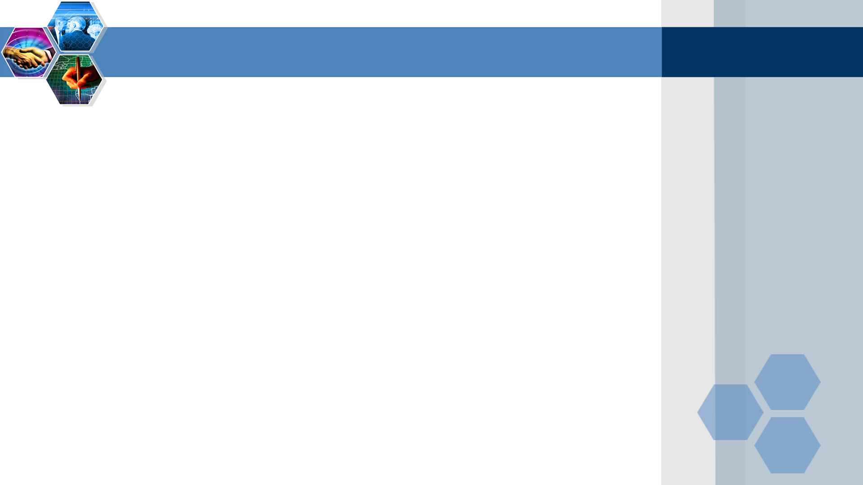






What’s the Internet: “nuts and bolts” view
PC
millions of connected computing devices: hosts = end systems
server
running network apps
wireless
laptop
smartphone
communication links
fiber, copper, radio, satellite
transmission rate = bandwidth
wireless
links
wired
links
Packet switches:
forward packets (chunks of data)
routers and switches
router

Slide 3

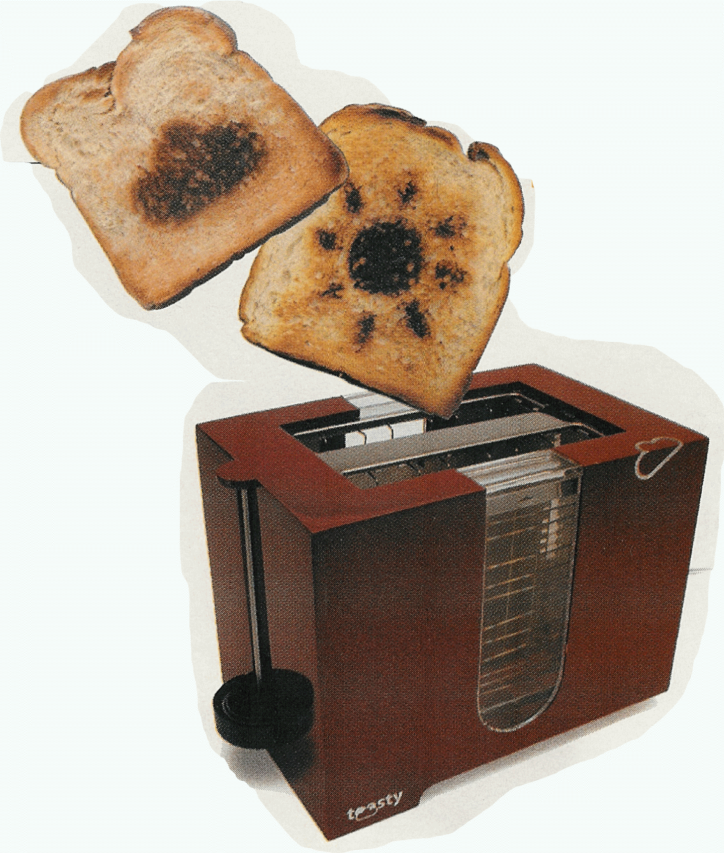
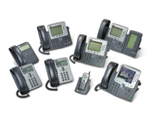

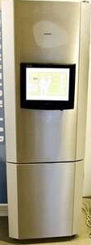
“Fun” internet appliances
Web-enabled toaster +
weather forecaster
IP picture frame
http://www.ceiva.com/
Tweet-a-watt:
monitor energy use
Slingbox: watch,
control cable TV remotely
Internet phones
Internet refrigerator

Slide 4














What’s the Internet: “nuts and bolts” view
What’s the Internet:“nuts and bolts” view
mobile network
Internet: “network of networks”
Interconnected ISPs
global ISP
protocols control sending, receiving of msgs
e.g., TCP, IP, HTTP, Skype, 802.11
home
network
regional ISP
Internet standards
RFC: Request for comments
IETF: Internet Engineering Task Force
institutional
network

Slide 5
What’s the Internet: a service view
mobile network
Infrastructure that provides services to applications:
global ISP
Web, VoIP, email, games, e-commerce, social nets, …
home
network
regional ISP
provides programming interface to apps:
hooks that allow sending and receiving app programs to “connect” to Internet
provides service options, analogous to postal service
institutional
network

Slide 6
The topology structure
Star
Tree
Bus
Ring
Mesh
Network Node + communication lines, reflecting the network structure of the inter-entity relations

Slide 7
What’s a protocol?
machines rather than humans
all communication activity in Internet governed by protocols
“what’s the time?”
“I have a question”
introductions
network protocols
human protocols
protocols define format, order of msgs sent and received among network entities, and actions taken on msg transmission, receipt
… specific msgs sent
… specific actions taken when msgs received, or other events

Slide 8


What’s a protocol?
a human protocol and a computer network protocol:
Hi
TCP connection
request
Hi
TCP connection
response
Got the
time?
Get http://www.awl.com/kurose-ross
2:00
<file>
time
Q: Other human protocols?

Slide 9
关于网络协议的说明
计算机网络中的数据交换必须遵守事先约定好的规则。
这些规则明确规定了所交换的数据的格式以及有关的同步问题（同步含有时序的意思）。
网络协议(network protocol)，简称为协议，是为进行网络中的数据交换而建立的规则、标准或约定。

Slide 10
网络协议的组成要素
语法 数据与控制信息的结构或格式 。
语义 需要发出何种控制信息，完成何种动作
以及做出何种响应。
同步 事件实现顺序的详细说明。

Slide 11

A closer look at network structure
network edge:
hosts: clients and servers
servers often in data centers
access networks, physical media: wired, wireless communication links
network core:
interconnected routers
network of networks

Slide 12

Summary
Internet overview
Topology
Protocol
Internet structure

